Slide 1

TITLE LIBRARY MANAGEMENT SYSTEM
Group Members
Taha Rehman Haroon 054
Umair Qaiser 057
Taheer Abdullah 055

Slide 2

LIBRARIES
- iostream
Input/Output Stream
- fstream
For File Handling
- windows.h
Commands like system(“CLS”) and system(“Color 03”) and Sleep(“1500”) used for better output

Slide 3
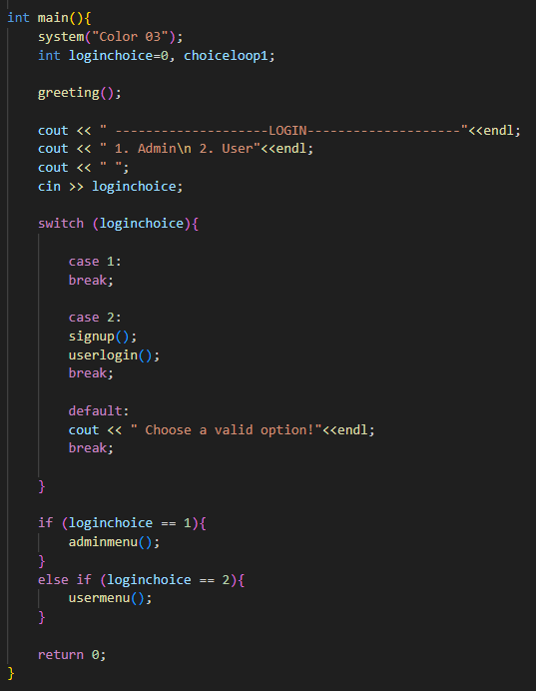
INT MAIN
In the main function greeting function is first called
Then it is asked whether admin is logging in or user
If it is admin then the program runs according to admin functions
Otherwise user can sign up or login and program will run according to user functions

Slide 4
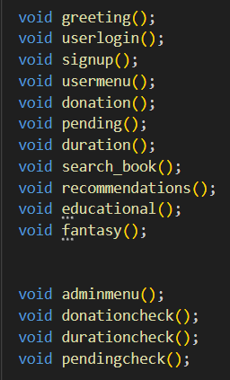
FUNCTIONS

Slide 5
void greeting
A simple function displaying welcome message to the user
Used to keep the int main function clean

Slide 6
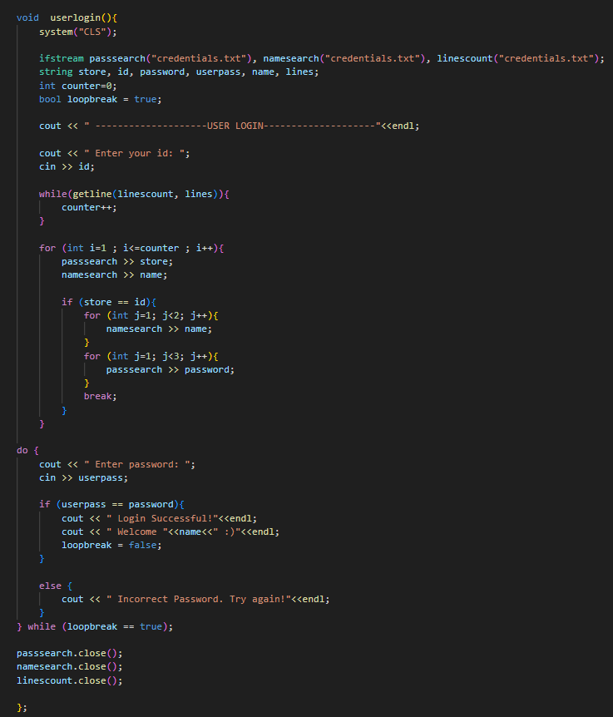
void userlogin
This function asks for user id
Then it searches the text file holding all the users passwords and ids and names
The file is also searched to store password from file
Name of the user is also searched in file for display
When entered id is matched the user is asked for password
User then enters password till it is the correct password

Slide 7
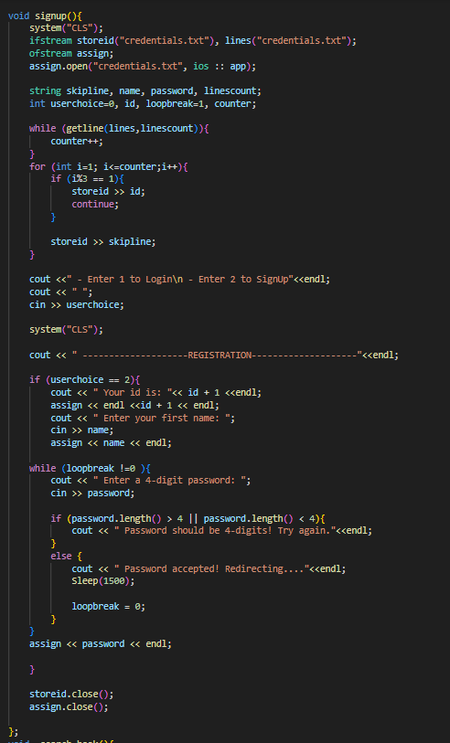
void signup
This function asks the user if they want to log in or sign up
When log in selected the function is ignored
Otherwise, this function first stores the new users id by checking previous users ids to eliminate chances of duplicating
Then it asks for name and password of the user
The user has to enter password until it is 4 digit password
Once accepted, the information is stored in credentials text file
Now the user can login in future and will not have to sign up

Slide 8
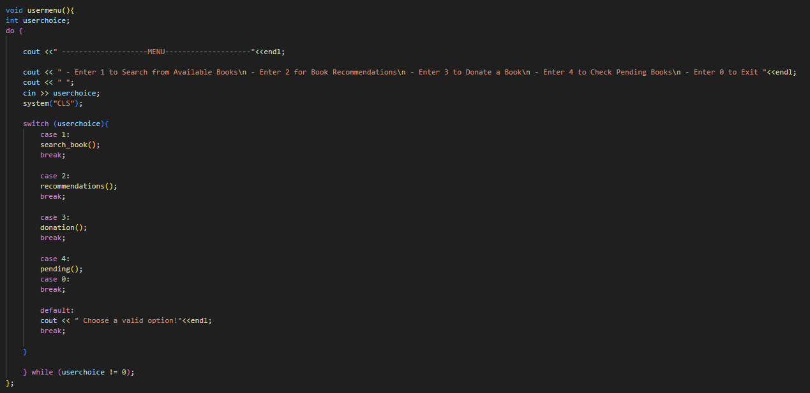
void usermenu
This function displays user multiple options to choose from
Respective function is then called according to what option user enters
For example: On entering 3, donation function will be called and user will be able to donate a book

Slide 9
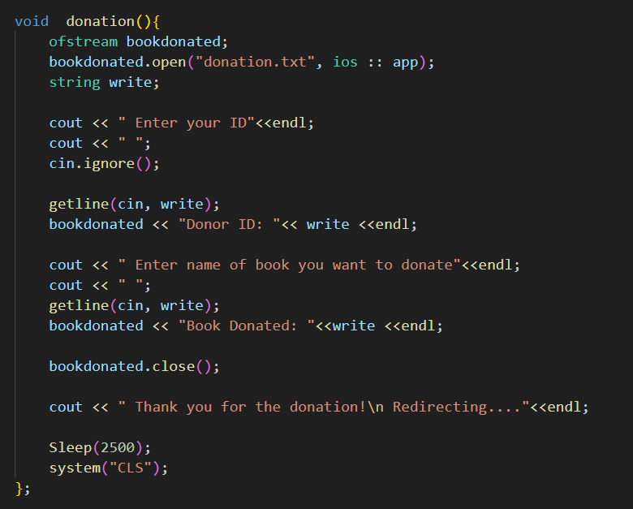
void donation
This function first asks the user for id and writes it in donation text file
Then it asks the user for the name of book they want to donate and writes it in the donation text file
This way a record of donors can be stored and updated

Slide 10
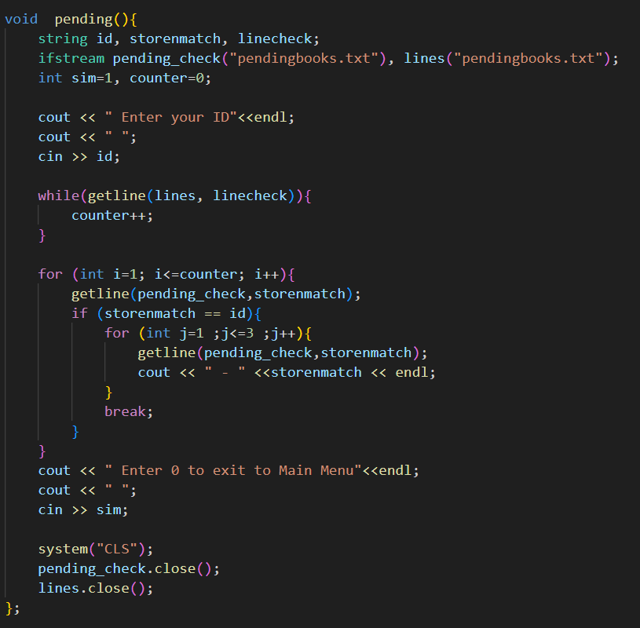
void pending
This function first asks the user for their id
When the id is entered it searches the pending books text file
Once the id is matched it displays the books under that id
User can look for as long as they want and press 0 to exit to main menu
This way a user can check their pending books

Slide 11
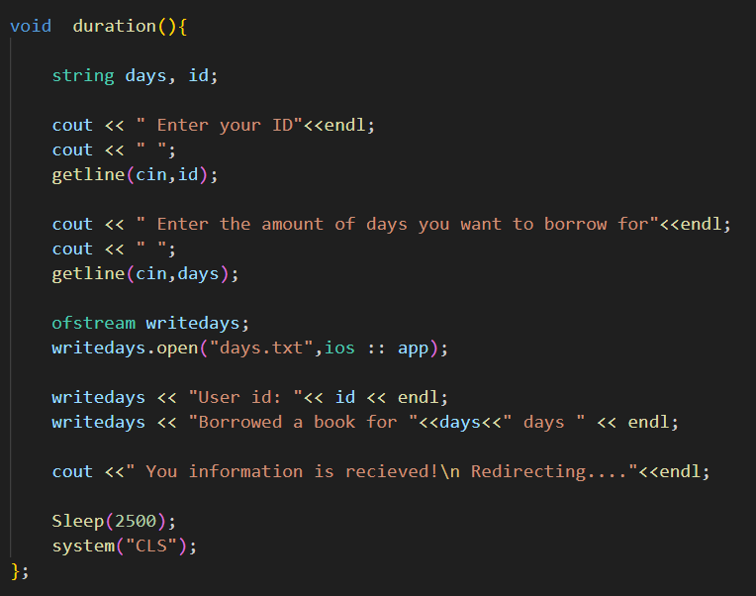
void duration
This function is called to store information for example: how many days is the user taking it for?, when the user is borrowing a book
This function first asks for user id
Then it asks for the amount of days
Then it writes down user id and amount of days in days text file

Slide 12
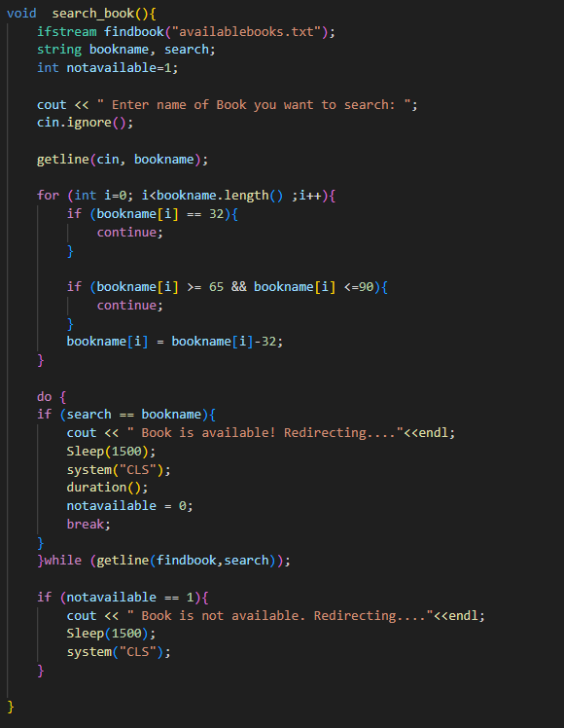
void search_book
This function asks the user to enter name of book they want to search
Then the entered name is converted to uppercase so it can be matched
Then the available books text file storing 100 books is searched
If the book name is found then duration function called
Else the message is shown that book is not available

Slide 13
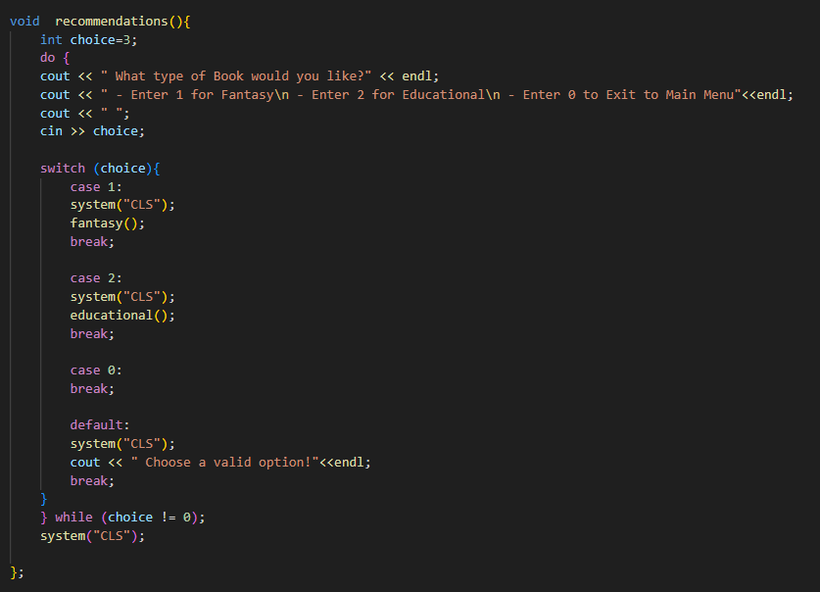
void recommendations
This function shows the user options to choose books from
First it asks the genre (or type) of the book that the user wants
Then according to choice fantasy or educational functions are called
Fantasy function lets user choose from fantasy books
Educational function lets user choose from educational books

Slide 14
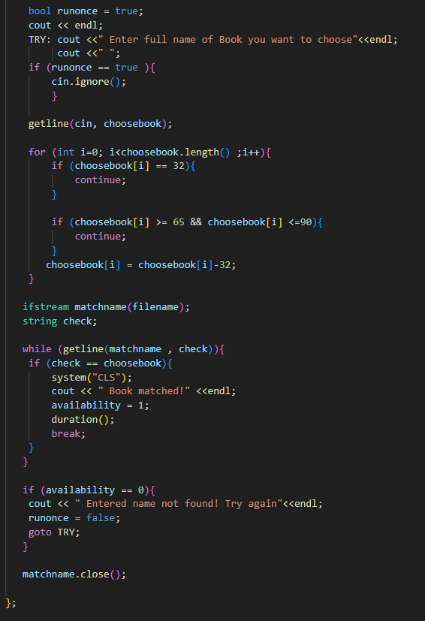
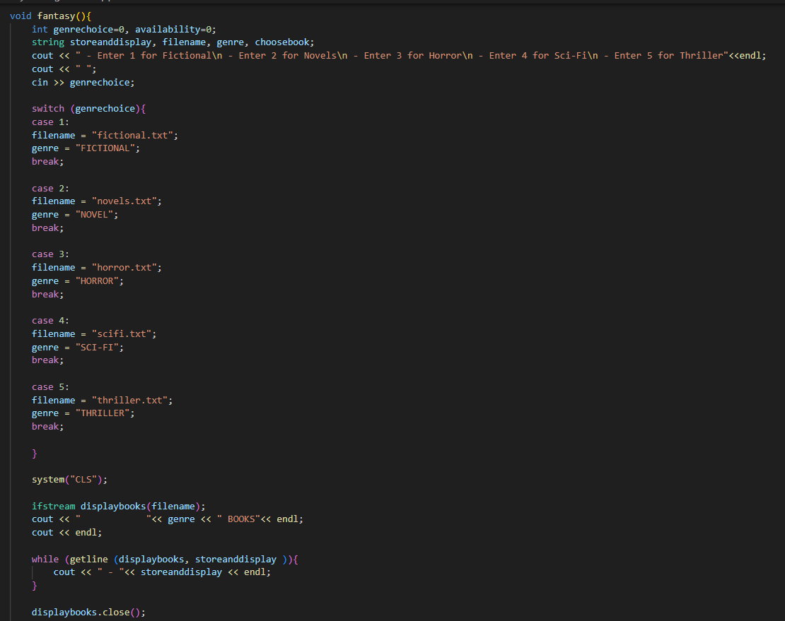
void fantasy

Slide 15
void fantasy
This function displays types of books in fantasy section
Then the text file holding that types book is opened
Then all the books available in that file are shown
Then the user is asked to enter name of book they want
The name is then converted to uppercase so it can be matched
In case the user enters wrong spelling he/she is asked to enter the name again
Once accepted the duration function is called so record can be stored

Slide 16
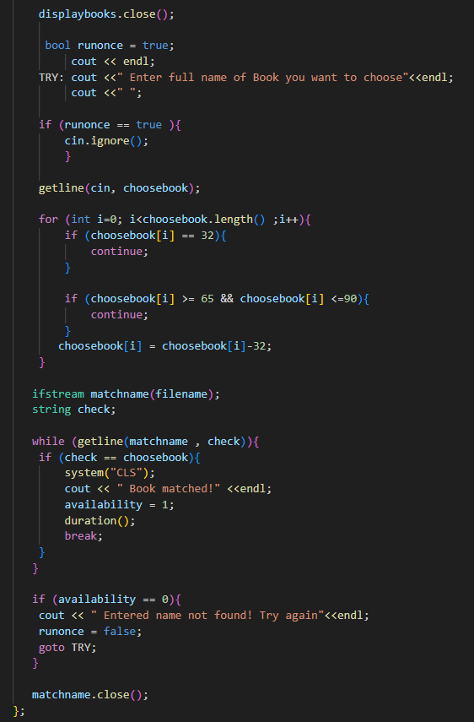
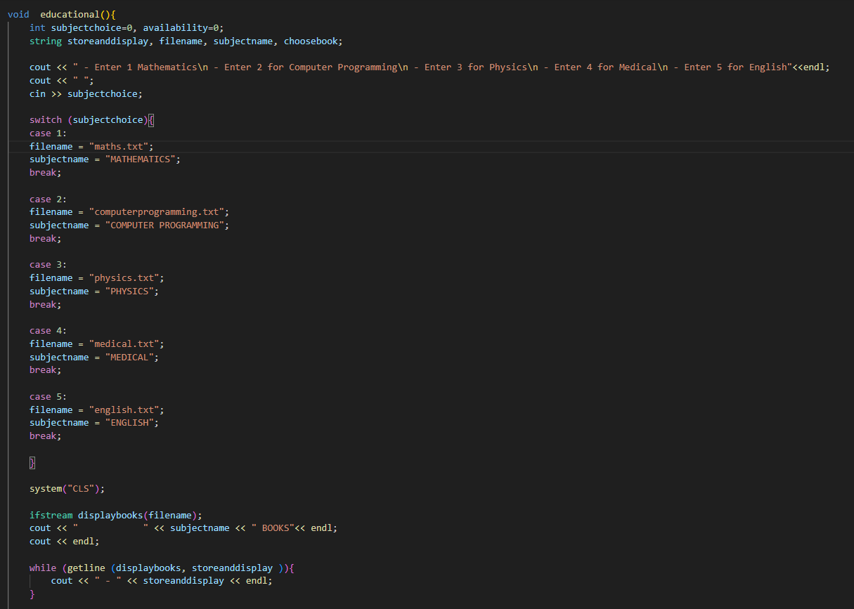
void educational

Slide 17
void educational
This function displays types of books in educational section for example: mathematics
Then the text file holding that types book is opened
Then all the books available in that file are shown
Then the user is asked to enter name of book they want
The name is then converted to uppercase so it can be matched
In case the user enters wrong spelling he/she is asked to enter the name again
Once accepted the duration function is called so record can be stored

Slide 18
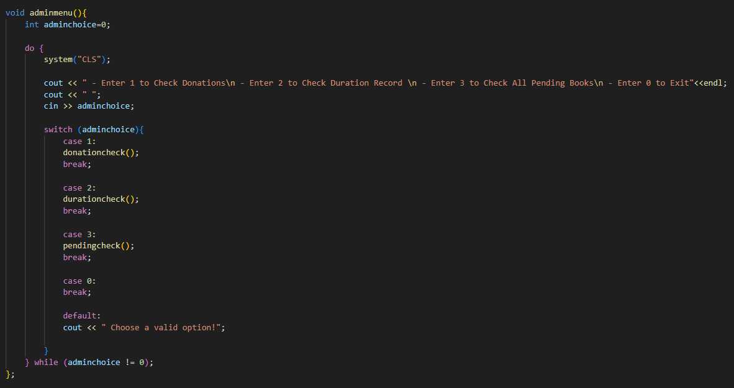
void adminmenu
This function displays admin multiple options to choose from
Respective function is then called according to what option admin enters
For example: On entering 1, donationcheck function will be called and admin can check donors record

Slide 19
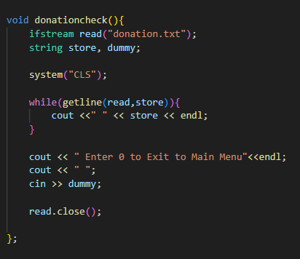
void donationcheck
This function reads the donation text file using file handling
Then all the record stored for eg: donor names and books donated are displayed to the admin
The record will be on display till admin enters 0 to exit to main menu

Slide 20
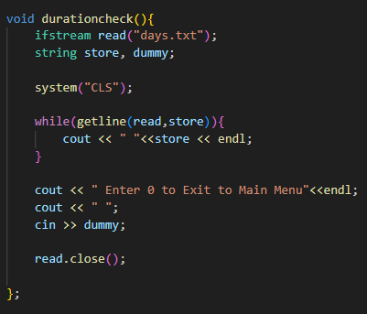
void durationcheck
This function reads the days text file using file handling
Then all the record stored for eg: user id and the amount of days book is borrowed for is displayed to the admin
The record will be on display till admin enters 0 to exit to main menu

Slide 21
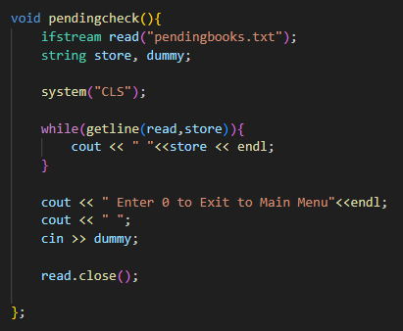
void pendingcheck
This function reads the pending books text file using file handling
Then all the record stored for eg: user names and the pending books for all users is displayed
The record will be on display till admin enters 0 to exit to main menu

Slide 22
IMPORTANRT TEXT FILES
Days.txt
Donation.txt
Credentials.txt

Slide 23
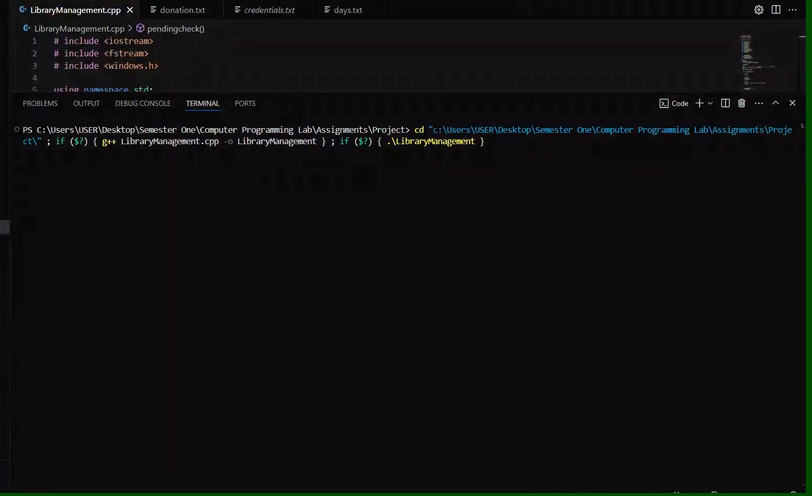
SIGNUP PROCESS

Slide 24
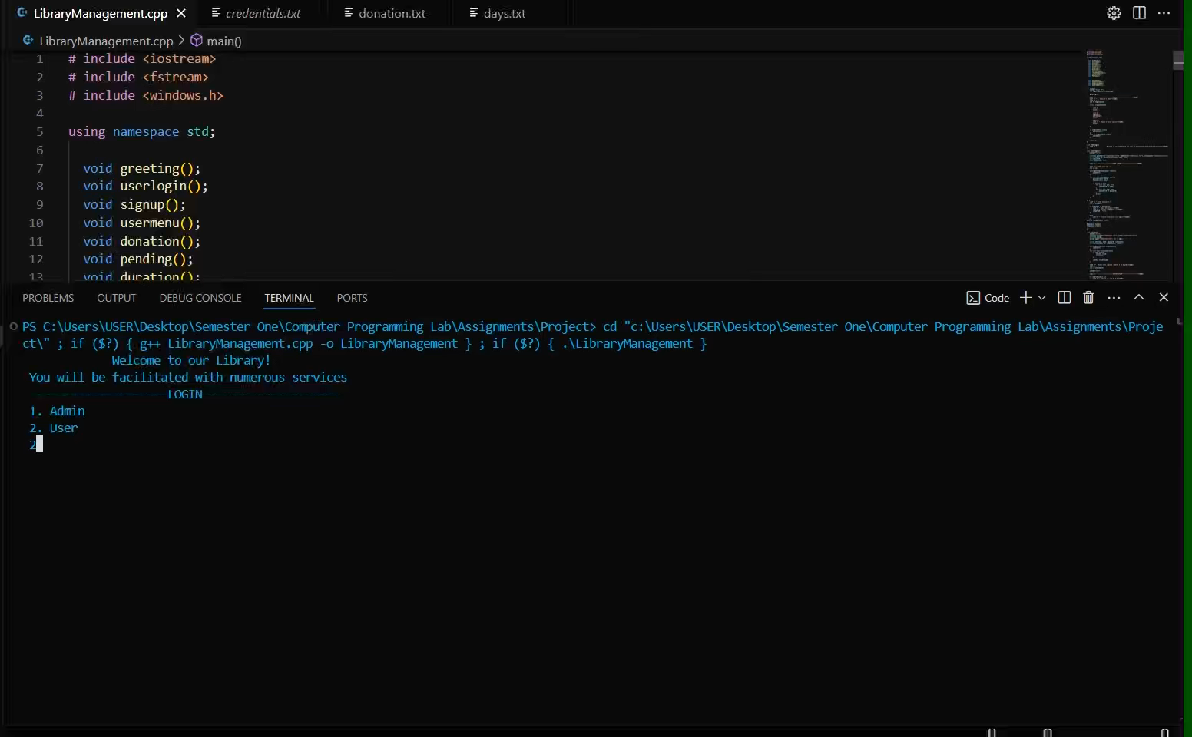
DONATION, DURATION, PENDING CHECK

Slide 25
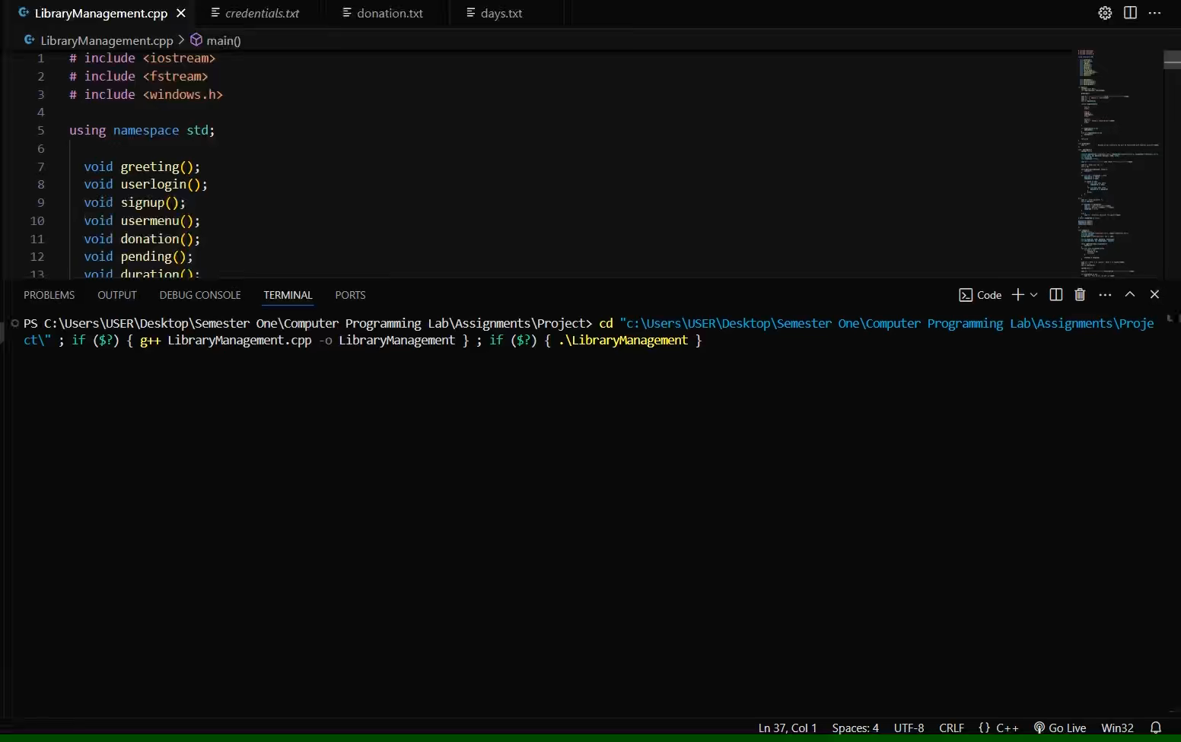
ADMIN PROCESS

Slide 26
THE END

